Slide 1
GAME GARAGE
Neiell Paradiang
Marjun Makinano
Mar Rynner Yee
Rex Ivan Villaroza
Aldrin Cadeliña

Slide 2
Vision
To create a web app that provides relevant information on games

Slide 3
Mission
To create a web application with information of games

Slide 4
Objectives
Within 1 week after October 4, 2015 we will gather all the information of the games and have created sprints.
After 1 week of data gathering we have finished planning our database
After 1 week of planning the database, we have finished our database
After creating the database, in 1 week we have finished our 1st sprint which is the log in/ log out/ sign up and change password
After finishing the 1st sprint, in 1 week we have finished our 2nd sprint which is the Category of Games and Redirecting System
After finishing the 2nd sprint, in 1 week we have finished our 3rd sprint which is the Search System

Slide 5
Objectives (cont’d)
After finishing the 3rd sprint, in 1 week we have finished our 4th sprint which is the Feedback and Request Game
After finishing all the sprints, in 1 week we will polish our UI
After polishing our UI, we will test the site itself for 3 days

Slide 6
Principle
User’s satisfaction is primary

Slide 7
Feature List
Sign up
Log in
Log out
Search System
Category of Games
Redirecting System
Game Information
Request Game
Feedbacks
Change Password

Slide 8
Feature Acceptance Criteria
Sign up
Log in
Log Out
In sign up, users will be redirected to the sign up page and after successfully signing up there will be a prompt that will show them that they have successfully registered and will then be redirected to the log in page
After successfully logging in, users will be redirected from the log in page to the home page
After successfully logging out users will redirected to the log in page

Slide 9
Redirecting System
Feedback
Users can click on a link that is in the game information will redirect them to the game’s website
Signed up users can write reviews and after clicking submit their feedback will show on the feedback portion of the game

Slide 10
Category of Games
Search System
After hovering on the category tab, there will be a dropdown box that will show all the categories and after clicking on a category. It will show all the games on that category
Typing keywords in the search bar, a list will show of all the games that matched the keyword

Slide 11
Request Game
After clicking on the request tab, users will be redirected to the request page and request a game they want considered they know the title then a prompt will be shown that they were successful.
The requested game will be posted on the request page of the admins account

Slide 12
Request Game
After clicking on the request tab, users will be redirected to the request page and request a game they want considered they know the title then a prompt will be shown that they were successful.
The requested game will be posted on the request page of the admins account

Slide 13
Change Password
After clicking on the change password button, the user will be redirected to the change password page and he will fill up a form to change his/her password.
After clicking the submit button and there are no invalid characters in the form, there will be a prompt saying that he has successfully changed his/her password

Slide 14
User Stories
As an admin, I want to add information of a game so that it can be viewed
As an admin, I want to update the information of a game so that it is updated
As an admin, I want to delete the information of a game so that any obsolete information will be gone
As a user, I want to view information on games so that I am well informed
As a user, I want to be able to register so that I can fully access the site
As a user, I want to log in to my account so that I can fully access the site
As a user, I want to be able to log out my account so that I can keep it safe

Slide 15
User Stories(cont’d)
As a user, I want to leave some feedbacks so that other users can know what I think
As a user, I want to search games so that I can easily find the game I am looking for
As a user, I want to be able to view the genres of the games so that I can find related games
As a user, I want to be able to visit the game’s website so that I can download or buy the game
As a user I want to request games so that I can have information of a game I want
As a user, I want to be able to view my account so that I can edit my user settings

Slide 16
User Stories(cont’d)
As a user, I want to be able to recover my password so that if I forget it I will still be able to recover it
As a user, I want to change my password so that I can make my account more secure

Slide 17
Story Acceptance Criteria
Add Information
Update
When the add button is clicked, the form that the admin filled out will be posted on the site after the prompting that it was posted successfully
When the confirm button is clicked, the information of the game that the admin picked will be updated

Slide 18
Story Acceptance Criteria
Delete
Change Password
When the confirm button is clicked, the information of the game that the admin picked will be deleted
After clicking the submit button, the password of the user will be changed and there is a prompt saying that it is successful

Slide 19
Story Acceptance Criteria
Recover Password
When the “Forget Password” button is clicked, the user will be given an email containing their password

Slide 20
Story Acceptance Criteria
View Information
Register
When you click on the game title, the user will be redirected to a page with the game’s information
After clicking the register button, there will be prompt saying that you have successfully registered considering the info was correct otherwise it will prompt and error message

Slide 21
Story Acceptance Criteria
Log in
Log out
After clicking the log in button and the information matched one account on our database then the user will be redirected to the home page otherwise an error message will prompt
After clicking the log out button, the user will be redirected to the log in page

Slide 22
Story Acceptance Criteria
Feedbacks
After clicking the submit button, the user will be prompted a successful prompt and the feedback that they wrote will be posted on the feedback portion

Slide 23
Story Acceptance Criteria
Search
View the Genre of the games
After typing a keyword, the user will see a list of games that matched the keyword
After clicking the category tab, the users will see a drop down box of all the genres and they can click one of the genres and it will redirect them to a page with a list of all the games with that genre

Slide 24
Story Acceptance Criteria
Visit the Game’s website
Request games
After clicking the link on the game’s information, the users will be redirected to the game’s website
After clicking the submit button, the user will see a successful prompt and will see the list of the games that have been requested

Slide 25
Roles
User
Admin
The user browses the information available on the website and search for the game’s information
The admin is responsible for creating, updating and deleting information of the games

Slide 26
Role Attribute
User
Frequency of use: Everyday
Domain Expertise: Moderate
Computer Expertise: Good
General Goals: View information

Slide 27
Role Attribute
Admin
Frequency of use: Everyday
Domain Expertise: Excellent
Computer Expertise: Excellent
General Goals: Add, Update and Delete information

Slide 28
Persona
(User) Denise is a gamer that wants to play new games of a certain Genre. Denise decided to just find any game of that genre and play it. But Denise had a hard time finding games and was searching the net when Denise found Game Garage. After finding Game Garage Denise found out that finding games is easier and that there are a lot of other games out there.
(Admin) Chap was a blogger that likes games. He was hired by the owner of the website to manage the site. His job is to add the information of a requested game, update the information and delete the information on games

Slide 29
Business Rule
When signing up, the user can only use the alphanumeric characters and the password has a required field of 6-22 valid characters
The email is unique to every account that is recorded in the database
When signing up, the information must be complete such as the email, password and confirm password
When filling up the Password and Confirm password must be the same
The username and password must correspond to 1 entry in the database when logging in

Slide 30
Business Rule
The user and the admin has different access rights
The users that has not logged in will only be able to view some of the information of a game that is listed
When the admin adds a game, all the information on it must be complete
The feedback is limited to 500 characters

Slide 31
Use Cases
Name: Sign up
Actor: User
Pre-condition: User hasn’t signed up
Post-Condition: The user’s account will be recorded in the database
Main Course:
The user clicks the sign up button
The user will be redirected to the sign up page
The user fills up the sign up form
The user clicks the submit button
Exception
If the user has an invalid entry. Go back to 3
A prompt will show that the user is successful in signing up
Exit
Use Case 1

Slide 32
Use Cases
Name: Log in
Actor: User
Pre-condition: User has already registered
Post-Condition: The user will be logged in
Main Course:
The user clicks the log in button
The user will be redirected to the log in page
The user fills up the log in form
The user clicks the log in button
Exception
If the info the user inputted doesn’t match anything in the database. Go to step 3
The user will be redirected to the homepage and his status will be shown as logged in
Exit
Use Case 2

Slide 33
Use Cases
Use Case 3
Name: Log out
Actor: User
Pre-condition: User has already logged in
Post-Condition: The User will be logged out
Main Course:
The user clicks the log out button
The user will be redirected to the log in page
(Alternative) If there are multiple tabs open and the user already logged out in 1 tab, If the user refreshes the page or go to another page on a tab he will be automatically logged out
Exit

Slide 34
Use Cases
Use Case 4
Name: Category
Description: A list of genres of games will be shown in a drop down box
Actor: User
Pre-condition: The user is in the home page
Post-Condition: The user will see the list of games of the genre
Main Course:
The user clicks the category tab and there will be a drop down box that shows the genre list
The user selects a genre in the drop down box
The user will see the list of games of the genre he/she selected
Exit

Slide 35
Use Cases
Name: Search System
Description: Users will be able to search for games using keywords
Actor: User
Pre-condition: The user is in the Home page
Post-Condition: The user will see a list of results
Main Course:
The user fills up the search bar
The user clicks the search button
The user will see the list of results
Alternative
If there are no matches in the database the user will be shown a page saying “No Result”
Exit
Use Case 5

Slide 36
Use Cases
Name: Feedback
Description: The user will be able to write their feedbacks on a certain game
Actor: User
Pre-condition: The User is on the game’s information page
Post-Condition: The feedback is shown in the feedback portion of the game info
Main Course:
The user clicks on the “Write a Review” button
The user will write his/her feedback on the form
Exception
Business Rule #9, go back to 2
The user’s feedback will be recorded in the database
The user will see the feedback on the feedback portion of the game’s info
Exit
Use Case 6

Slide 37
Use Cases
Use Case 7
Name: Game Info
Actor: User
Pre-condition: There is existing information on the game
Post-Condition: The user can view the information of the game
Main Course:
The user chooses and clicks the title of the game that he wants to view the info
The user will be redirected to a page where he can view the information of the game
Exit

Slide 38
Use Cases
Use Case 8
Name: Requesting Games
Actor: User
Pre-condition: The game is currently not in the database
Post-Condition: The requested game is listed on the list
Main Course:
The user clicks on the request tab
The user will fill up a form with information of the game they want to request
The requested game will be listed in the requested game list.
Exception
If the Requested Game is already on the Database, there will be a prompt saying its already in the site. Exit
Exit

Slide 39
Use Cases
Use Case 9
Name: Adding Games
Actor: Admin
Pre-condition: The user have requested a game via the request system
Post-Condition: The Game and its information will be posted on the site
Main Course:
The user have requested a game that will be shown on the requested list
The admin will input the information of the game that was requested
The game that the admin added will be shown on the site
Exception
If the game the admin will add is already on the database, prompt saying its already in the site. Exit
Exit

Slide 40
Use Cases
Use Case 10
Name: Redirecting System
Actor: User
Pre-condition: The user is in the page of the game
Post-Condition: The will be redirected to the game’s own website
Main Course:
The user has viewed and is currently in the page of a game’s information
The user will click on a link in the game’s information
The user will be redirected from the game’s information of our site to the game’s own website
Exit

Slide 41
Use Cases
Name: Password Recovery
Actor: User
Pre-condition: The user is in the log in page
Post-Condition: The user will receive an email containing his/her password
Main Course:
The user clicks the forget password button
The user will be redirected to a page containing a field to write his/her email in
After clicking the confirm button. The user will see a prompt saying that it has been sent to the email provided and in that email he will see his password
Exception
If the email provided is not in the database, show an error then exit
Exit
Use Case 11

Slide 42
Use Cases
Name: Change Password
Actor: User
Pre-condition: The user is in the Home Page
Post-Condition: The user will have changed his/her password and is reflected in the database
Main Course:
The user clicks the change password button
The user will be redirected to a page containing a field to write his/her password in and another 2 fields to write the new password and to confirm the new password
After clicking the confirm button. The user will see a prompt saying that his/her password has been successfully changed
Exception
If the new password he inputted has an invalid entry, go back to 2
If the Password and Confirm password does not match, go back to 2
Exit
Use Case 12

Slide 43
Use Cases
Name: Update Games
Actor: Admin
Pre-condition: The Game is already in the Site
Post-Condition: The information of the game will be updated
Main Course:
The admin clicks the update game button
The admin will be redirected to a page containing fields to write the new information of the game
After clicking the confirm button. The admin will be redirected to the view games page
Exception
If the new changed title is already in the database there will be an error message
Exit
Use Case 13

Slide 44
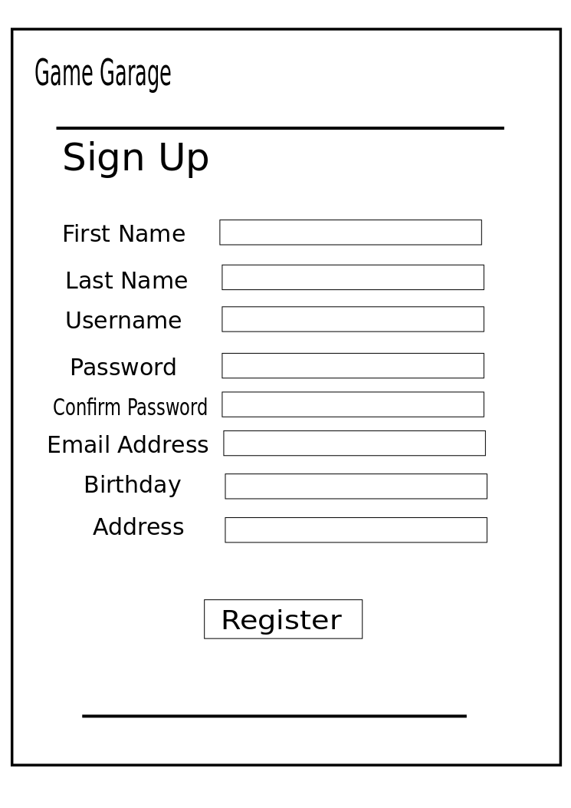
Test Cases
Sunny Case
All the Fields of the form are filled up
There are no invalid characters in the form
The password is within the limit
Rainy Case
There are invalid characters in the form.
The password did not reach the minimum or exceeded the maximum length
Test Case 1
Sign up

Slide 45
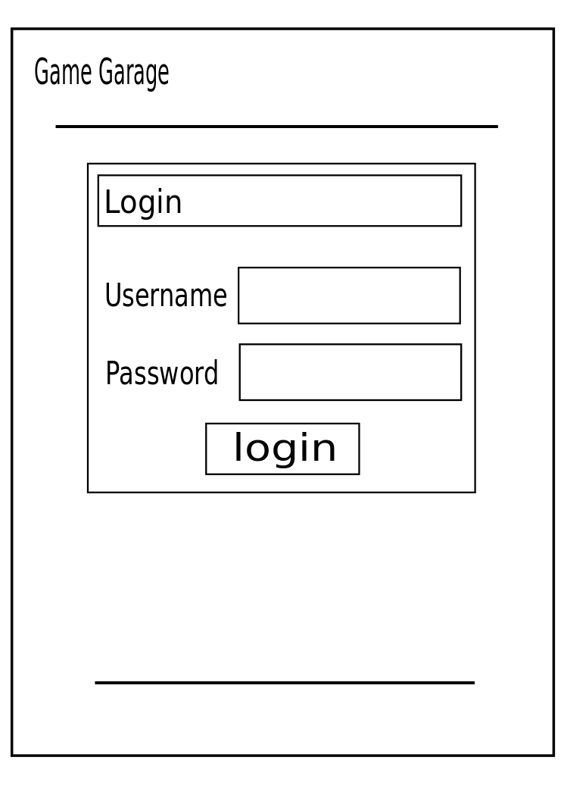
Test Cases
Sunny Case
When the Email and Password matched one data in the database
Rainy Case
If the Email and Password the user inputted didn’t match one data in the database
Test Case 2
Log In

Slide 46
Test Cases
Sunny Case
The user is currently logged in on his/her account
Rainy Case
None
Test Case 3
Log out

Slide 47
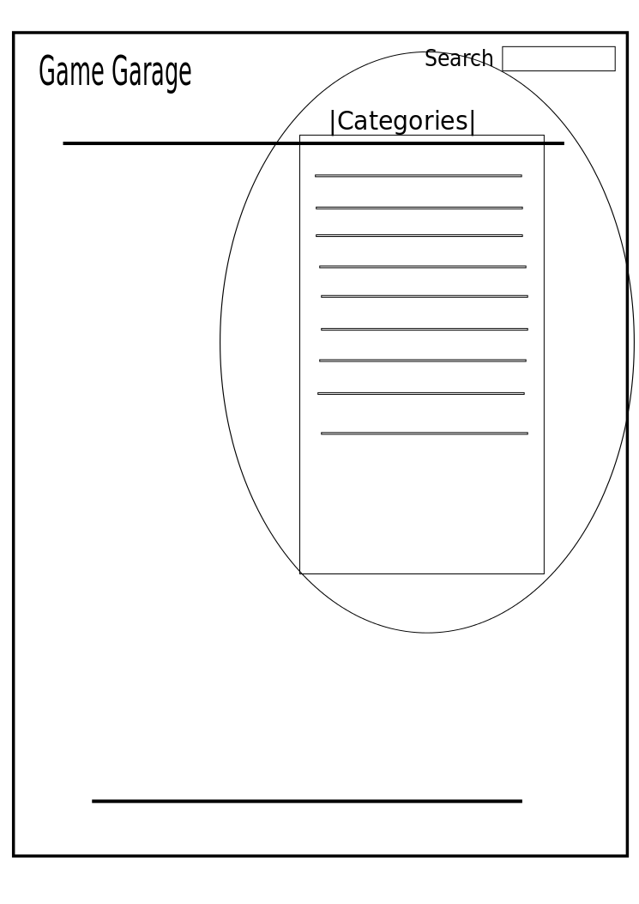
Test Cases
Sunny Case
The user clicked on a category
Rainy Case
None
Test Case 4
Category

Slide 48
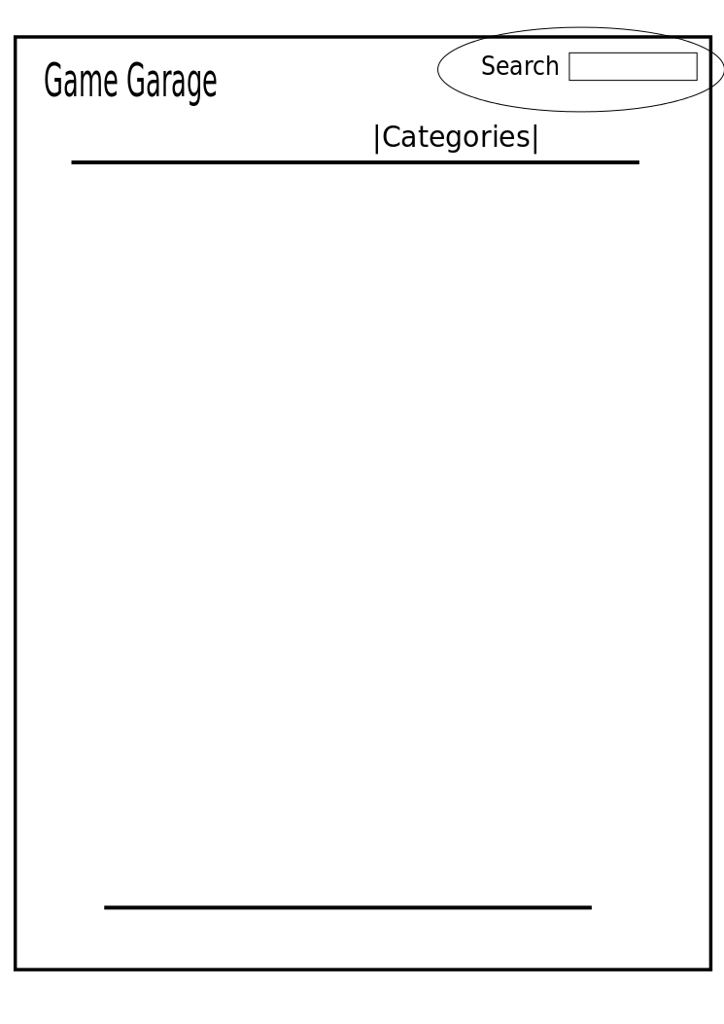
Test Cases
Sunny Case
There is at least 1 character in the search bar
Rainy Case
None
Test Case 5
Search System

Slide 49
Test Cases
Sunny Case
The characters are within the limit
There is at least one character in the field
Rainy Case
The characters exceeded the limit
There are no characters in the field
Test Case 6
Feedback

Slide 50
Test Cases
Sunny Case
There is an information on the game
Rainy Case
None
Test Case 7
Game Info

Slide 51
Test Cases
Sunny Case
The user fills up everything in the form
The game had not been requested
Rainy Case
The game has already been requested
Test Case 8
Request Game

Slide 52
Test Cases
Sunny Case
The admin fills up the form correctly
The game is currently not in the website
Rainy Case
The game is already on the site
Test Case 9
Adding Game

Slide 53
Test Cases
Sunny Case
There is an active link to the game’s website
Rainy Case
None
Test Case 10
Redirecting System

Slide 54
Test Cases
Sunny Case
The Email that requested to send the recovery password message is in the database
Rainy Case
The Email is not recorded in the database
Test Case 11
Password Recovery

Slide 55
Test Cases
Sunny Case
There are no invalid characters in the new password
The new password is the same as the confirm password
The new password length should be within the limit
Rainy Case
There is/are invalid character/s in the new password
The new password is not the same as the confirm password
The password length did not reach the minimum or exceeded the maximum length
Test Case 12
Password Recovery

Slide 56
Test Cases
Sunny Case
The admin fills up the form correctly
The new title of the game is currently not in the website
Rainy Case
If the updated title of the game is already on the site
There are invalid inputs in the fields
Test Case 13
Update Game

